Slide 2


Introduction to Azure AI Technologies
@
/in/

Slide 3
The Azure AI Landscape
Applications
Use AI
Artificial Intelligence in Applications
Cognitive services
Bot framework
Knowledge
Include AI
Artificial Intelligence from Pre-built Services, Apps, and Knowledge Mining
Machine Learning Services, Pretrained Models, Frameworks and Infrastructure, IoT
Create AI
Artificial Intelligence with Platforms, Infrastructure and Tools, Deploy to Edge
Azure Databricks
AI Solutions Gallery
Find AI
Artificial Intelligence Solutions in a Portal

Slide 4
Use AI - Agent
Cortana
1,000+ skills and knowledge, 133 million users | 12 billion questions

Slide 5

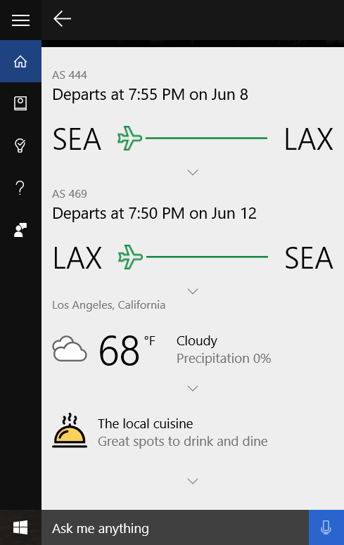

Slide 6
Use AI - Applications
Office 365
Skype
Dynamics 365
Teams
SwiftKey
Calendar.help
Pix
Customer Service and Support

Slide 7
Include AI - Services
Cognitive Services
Cognitive Services Customizations
Bot Framework
Knowledge Mining

Slide 8






Microsoft Cognitive Services Give your apps a human side
Vision
From faces to feelings, allow your apps to understand images and video
Speech
Hear and speak to your users by filtering noise, identifying speakers, and understanding intent
Language
Process text and learn how to recognize what users want
Knowledge
Map complex information and data in order to solve specific tasks
Search
Access billions of web pages, images, videos, and news with the power of Bing
Labs
An early look at emerging Cognitive Services technologies: discover, try, and give feedback on new technologies before general availability

Slide 9
Microsoft Cognitive Services
Vision
Speech
Language
Knowledge
Search
Labs
Video Indexer
Speaker Recognition
Text Analytics
QnA Maker
Bing Entity Search
Project Gesture
Computer Vision
Bing Speech
Bing Spell Check
Azure Search
Bing Autosuggest
Project Local Insights
Face
Custom Speech
Translator Text
Bing Search
Project Academic Knowledge
Emotion
Translator Speech
Language Understanding (LUIS)
Web Search
Project Entity Linking
Content Moderator
Unified Speech
Custom Vision
Image Search
Project Knowledge Exploration
Custom Vision
Speech to Text w. Custom Speech
News Search
Project Event Tracking
Text to Speech w. Custom Voice
Video Search
Project Answer Search
Speech Translation w. Custom Translator
Bing Statistics add-in
Project URL Preview
Bing Visual Search
Project Anomaly Finder
Bing Custom Search
Project Conversation Learner
Project Personality Chat

Slide 10
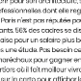


Knowledge Mining with Azure Search
Documents
AI Components
Full text-searchable rich index
Key Phrase extraction
Location entity extraction
Sentiment analysis
Organization entity extraction
Persons entity extraction
Language detection
TPS Reports
Face detection
Celebrity recognition
Tag extraction
Custom skills
Landmark detection
Printed text recognition
https://tinyurl.com/learnai-AzureSearch

Slide 11
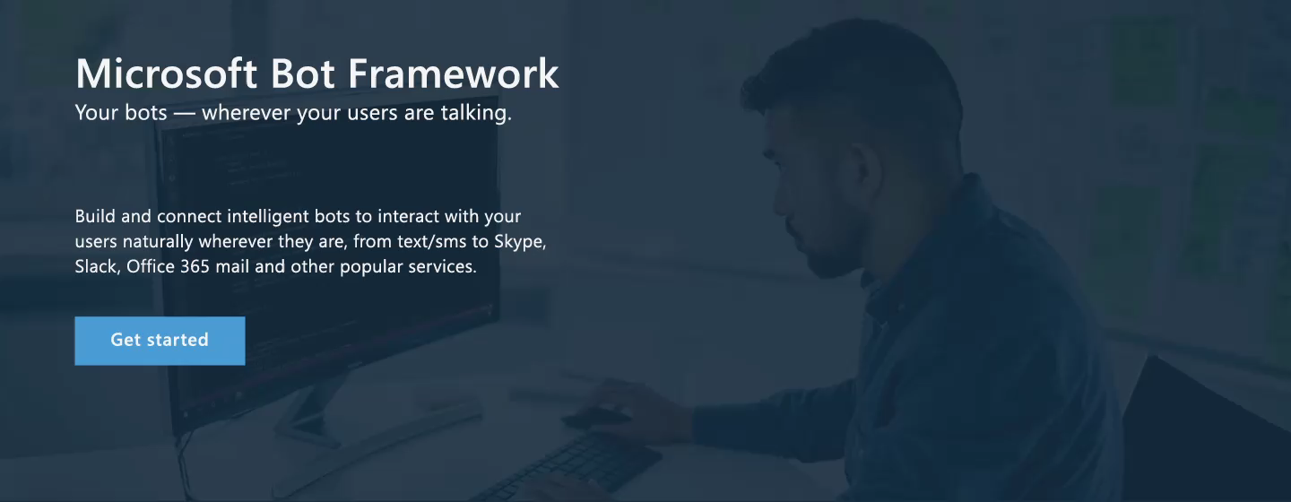
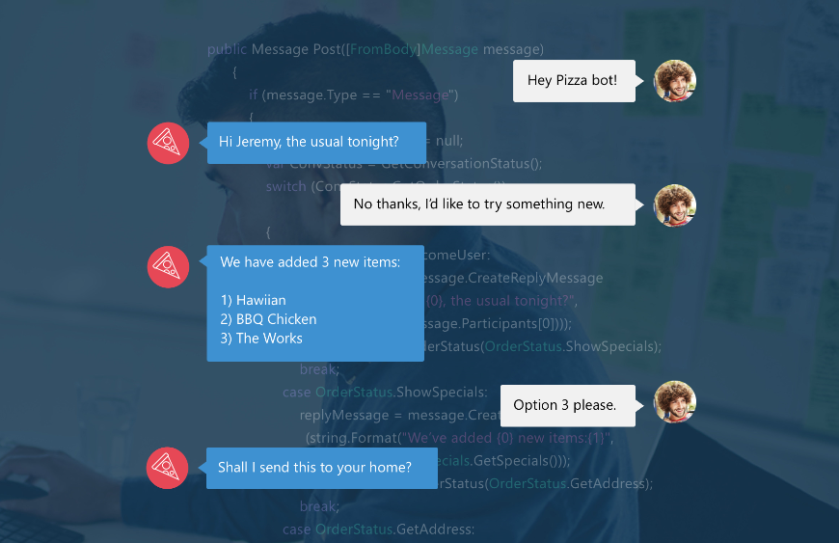
Bot Framework - Engage with your users
A natural language interface across all conversation channels
Insights
Operationalization
Provide information
Perform tasks
Make recommendations
Capture information

Slide 12






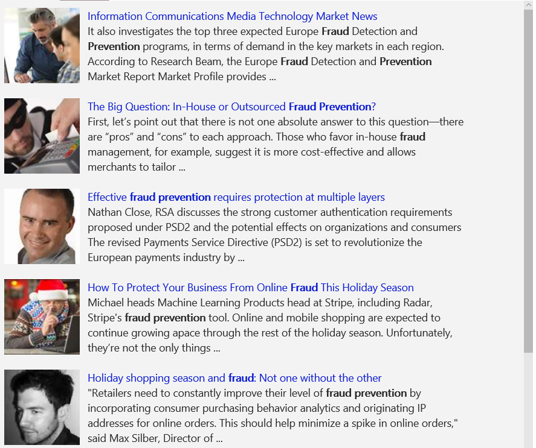
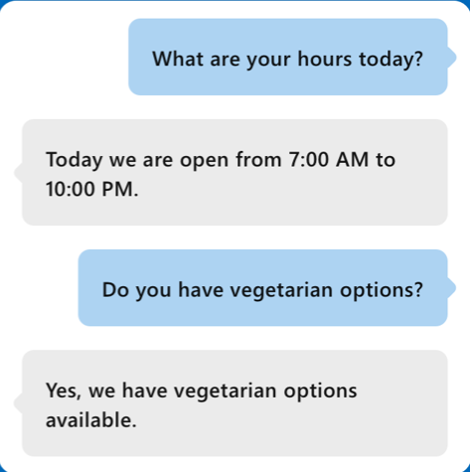
Combining Services for real-world applications
Vision
Speech
Language
Knowledge
Search
What is in the image or video?
Give me directions to the nearest local branch
Play today’s customer call recording
QnA Pair of this site?
Search for ‘fraud prevention’
Intelligent Image insights
Speech to text
Natural Language Processing
Automatic extraction of questions and answers
Intelligent web search
Information Communications Media Market News
It also investigates the top three expected Fraud Detection and Prevention programs, in terms of demand in key markets…
Intent: PlayCall
Content: Customer#
DateTime.date: today
The Big Question: In-House or Outsourced Fraud Protection?
First, let’s point out that there is not one absolute answer—there are “pros” and “cons” to each. Those who favor in-house…
Category | People; 5 faces
Adult/Racy? | False/False
Dominant colors
Accent color
Convert spoken audio to text
How to Protect Your Business from Online Fraud this Holiday Season
Michael heads fraud prevention tool. Online and mobile shopping are expected to continue growing apace…
Computer Vision
Speech Service
Language Understanding
QnA Maker
Bing News Search
Convert text to spoken audio
Now Playing
Extract intent of user
11/29/2016 Customer Call

Slide 13
Create AI - Infrastructure and Tools
Data Science Process
Pretrained Models
Azure Databricks
Services and Frameworks
Infrastructure

Slide 14
The Data Science Process
Business Understanding
Define Objectives
Identify Data Sources
Data Acquisition and Understanding
Ingest Data
Explore Data
Update Data
Modeling
Feature Selection
Create and Train Model
Deployment
Operationalize
Customer Acceptance
Testing and Validation
Handoff
Re-train and re-score
aka.ms/tdsp
Notes:
Data Science Blog - https://buckwoody.wordpress.com/

Slide 15






Machine Learning on Azure
Sophisticated pretrained models
To accelerate solution development with easy to use pretrained models
…
Vision
Speech
Language
Search
Cognitive Services
Popular frameworks
Build sophisticated deep learning solutions
Pytorch
TensorFlow
Keras
Onnx
Productive services
Empower your development teams
Azure Databricks
Azure Machine Learning
Machine Learning VMs
Powerful infrastructure
Accelerate time to value
CPU
GPU
FPGA

Slide 16






Popular Frameworks
Use your favorite deep learning frameworks
without getting locked into one framework
TensorFlow
PyTorch
Scikit-Learn
ONNX
Community project created by Microsoft and Facebook
Use the best tool for the job. Train in one framework and transfer to another for inference
MXNet
Chainer
Keras

Slide 17

Azure ML/AI Infrastructure
CPUs
GPUs
FPGAs
G
Ev3
M
NC
NCv2
NV
ND
FPGA
NCv3
NVv2
NDv2
(coming soon)
(coming soon)

Slide 18
Flexible deployment Deploy and manage models on intelligent cloud and edge
Train & deploy
Train & deploy
Track models in production
Capture model telemetry
Retrain models automatically
Deploy

Slide 19
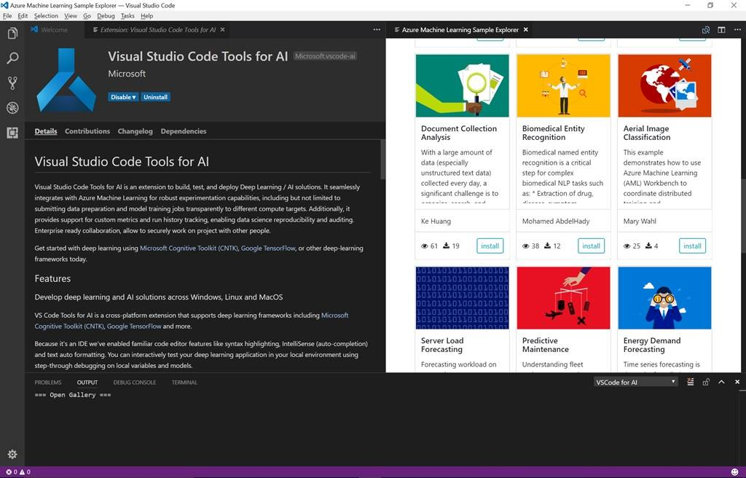
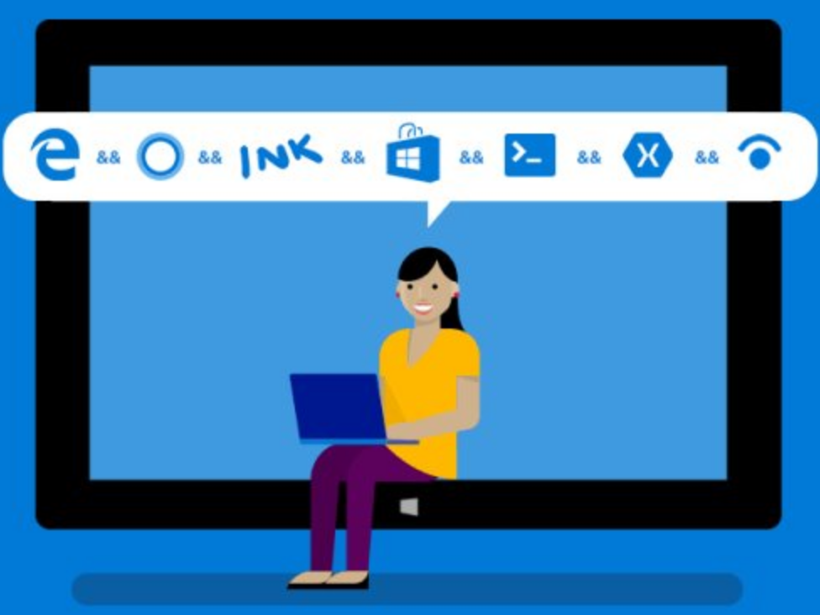
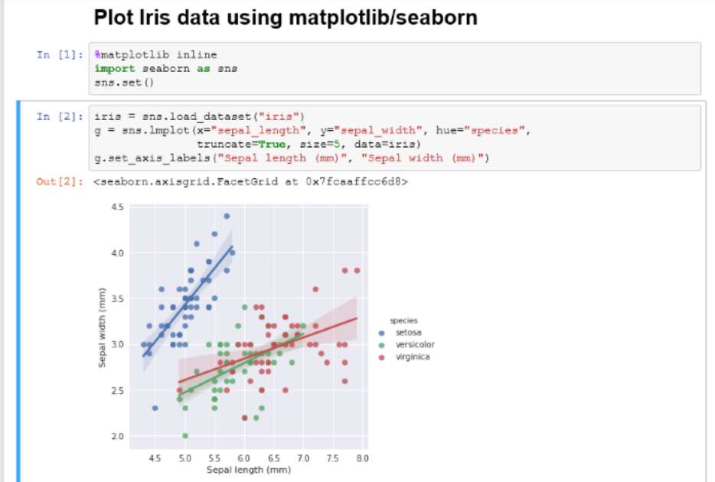
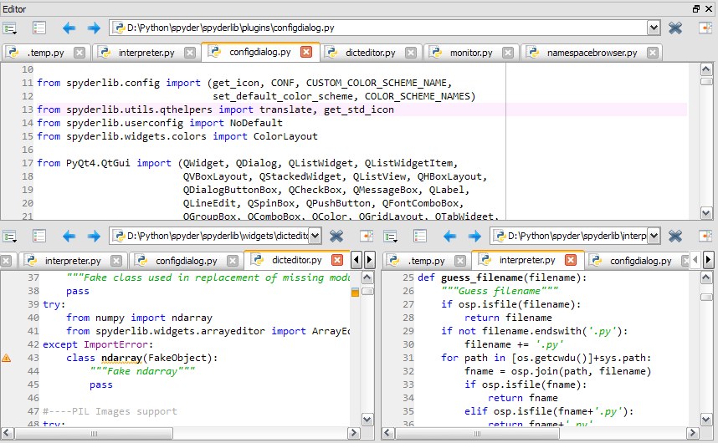
Development Tools: Jupyter, VS Code, Visual Studio, and 3rd Party,
SDK’s and R/Python Packages
(All available on the Azure Data Science Virtual Machine)
https://tinyurl.com/LearnAI-DSVM
Notes:
Data Science Blog - https://buckwoody.wordpress.com/

Slide 20
Find AI - Solution Portal

Slide 21
